Slide 1
Graduate Education and Research Directions
Dr. Tarek Sobh
Vice President Graduate Studies and Research Division &
Dean, School of Engineering
Distinguished Professor of Engineering & Computer Science
University of Bridgeport
E-Mail: sobh@bridgeport.edu
School of Engineering
University of Bridgeport
Graduate Education & Research Directions – 9.15.2010

Slide 2
Outline
Central Issues in Education and Research
Select New Directions
Engineering Problems and a Plan
Making the “Right” Engineers / Scientists
New Engineering Disciplines / Challenges and Our Signature Areas
Mechanisms for Supporting Research
Research Strategies and Techniques
Interdisciplinary Project Examples
School of Engineering
University of Bridgeport
Graduate Education & Research Directions – 9.15.2010

Slide 3
Central Issues In Education / Research
Some Thoughts from the Late Eighties
  Manufacturing and linkages with Design:
    Concurrent Engineering and the Product Realization Process
  Growing Role of the Computer and Software Tools
    Simulation, Visualization, Design
  Growing Importance of Information Technologies in All Disciplines
    Incipience of Multidisciplinary Education
  Comprehensive University / Industry Relations
School of Engineering
University of Bridgeport
Graduate Education & Research Directions – 9.15.2010

Slide 4
Central Issues in Education / Research
The Twenty-First Century
Manufacturing and Design in Micro and Nano Scales: MEMS and NEMS
Growing importance of Biological Sciences
Increasing Pressure to Transcend Traditional Academic Boundaries: Multidisciplinary Education
  Reduce rigidity of curriculum requirements and increase flexibility: Programs of study that meld previously disparate disciplines
Ever Expanding Impact of Information Technologies: The Internet and Wireless Communication Technologies
  Asynchronous and Synchronous Distance Learning
  The Virtual University
  The Virtual Laboratory Experience
  e-learning Courses
School of Engineering
University of Bridgeport
Graduate Education & Research Directions – 9.15.2010

Slide 5
Central Issues in Education / Research
The Twenty-First Century (Cont’d)
Socialization of Learning
  Student Centered Learning Activities
Relations with Industry: An Alternative Model
  Innovation and Entrepreneurship
The Research / Business Interface
Globalization
  International Study and Work Experience
School of Engineering
University of Bridgeport
Graduate Education & Research Directions – 9.15.2010

Slide 6
Select New Directions
First-Year Courses on Introduction to Systems
  Multidisciplinary, Experiential and Contextual
    Faculty participation from all disciplines
    Projects involve analysis, design, build and test activities that cross disciplinary boundaries and involve real applications
  Interactive and Collaborative
    Shift from faculty- and lecture-centered activities to student-centered activities
    Numerous team-based activities
School of Engineering
University of Bridgeport
Graduate Education & Research Directions – 9.15.2010

Slide 7
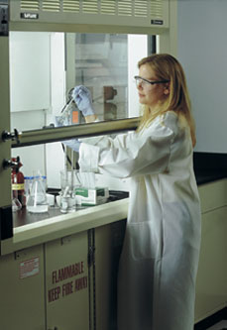

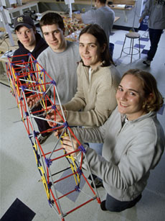
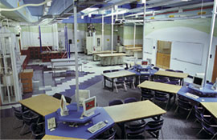
Select New Directions (Cont’d)
A Prototype Learning Center
  Computer Clusters for Collaborative Simulation
  and Design Activities
  Prototype Fabrication and Test Equipment
  Facilities for Conducting Experiments
  Group Work and Study Spaces
  Multimedia Presentation and Demonstration Area
School of Engineering
University of Bridgeport
Graduate Education & Research Directions – 9.15.2010

Slide 8
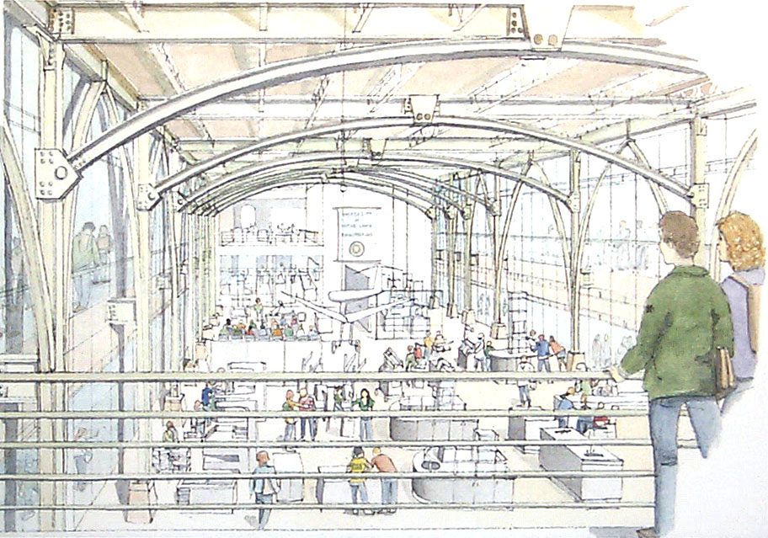
Select New Directions (Cont’d)
Learning Center in New Building
School of Engineering
University of Bridgeport
Graduate Education & Research Directions – 9.15.2010

Slide 9
Engineering Problem(s) and a Plan
Curriculum / Research based (partially) on constituents’ feedback, needs, vision, aspirations, problems (local, regional, national and global)
Leading versus following ?
“Functional” body of knowledge for leading edge technology development and to produce competent and interdisciplinary engineers and scientists.
New programs (outcome-based) utilizing outstanding and unique human and technology resources (let’s not fall into the .com trap again).
School of Engineering
University of Bridgeport
Graduate Education & Research Directions – 9.15.2010

Slide 10
Engineering Problem(s) and a Plan (Cont’d)
Traditional degrees (what does that mean ?) versus new interdisciplinary goal-oriented programs that cater to new complex real-world 21st century areas of interest and potential U.S. dominance.
Global competition (in what ?) Should we be scared ? How to solve it ?
New programs and collaborations (degree / within degree) driven by our vision of what the future “should be like”, not by what is the current state of the art. NO LIMITS (time to completion, etc.), example: ABET is making it easy at the undergraduate level !.
School of Engineering
University of Bridgeport
Graduate Education & Research Directions – 9.15.2010

Slide 11
Engineering Problem(s) and a Plan (Cont’d)
Quasi-Reverse brain drain (politics / Economics)
Europe, Asia, Canada, Australia very serious competition for brain power.
Continuing to attract international talent (remember K-12 problem) and need for aggressive recruiting at all levels and international cooperation / programs.
Profession Respectability / licensure, lobbying issues.
School of Engineering
University of Bridgeport
Graduate Education & Research Directions – 9.15.2010

Slide 12
Making the RIGHT Engineers/Scientists
Future Engineers (Joe Bordogna, COO NSF):
  Holistic designer
  Astute maker
  Trusted innovator
  Harm avoider
  Change agent
  Master integrator
  Enterprise enabler
  Knowledge handler
  Technology steward
Model for education suitable to the a new world in which change and complexity are the rule, a globally linked world that needs integration in many ways.
The Aftermath (Sam Florman, 2001), Prey (Crichton, 2002)
School of Engineering
University of Bridgeport
Graduate Education & Research Directions – 9.15.2010

Slide 13
New “Engineering” Disciplines / Trends and Our Signature Areas
“BIO”: Deliberate strategic response versus a natural evolutionary process (no definitive mandate ?)
Terascale: tera operations / compute power, terabyte storage, terabyte networking. Fascinating (for now) infrastructure. Applications: Communications, simulations / visualizations, real-time capabilities, etc.
Nanoscale: nano technologies / nano photonics, new materials / machines / living cells interface, precise control and manipulation at that scale [femto scale !] Also, MEMS and “smart dust” for agent detection, temperature, motion, vision sensing, etc.,
School of Engineering
University of Bridgeport
Graduate Education & Research Directions – 9.15.2010

Slide 14
New Disciplines, Trends and
Challenge Areas (Cont’d)
Cognition: above areas + neurosciences, perception, sensing, machine vision, agent-based systems, linguistics, psychologists, mathematics, robotics, automation, and many others interact.
Complexity, integration (traffic, weather, intelligent infrastructure and control systems, aerospace, aviation, large systems).
Advanced Materials and Manufacturing.
Information, communications and perception technologies (not only for defense, but many other applications)
Renewable energy and power systems.
We should not abandon all we know, but rather complement what we do with emerging paradigms
School of Engineering
University of Bridgeport
Graduate Education & Research Directions – 9.15.2010

Slide 15
New Directions (Cont’d)
Example : Bioengineering
A term with multiple meanings and implications
  Medical Engineering
    Prostheses
    Diagnostic and Surgical Tools
  Biotechnology
    Bioinformatics
    Biosensors
    Tissue Engineering
  Environmental Engineering/Science
    Remediation of organic wastes
    Biological destruction of carcinogens and
    toxic chemicals
Required molecular and cellular biology course for all engineering students
Departmental elective courses
School of Engineering
University of Bridgeport
Graduate Education & Research Directions – 9.15.2010

Slide 16
New Directions (Cont’d)
Integrated Research/Business Practice Courses
Fundamentals:
↓ The Corporation and it Financial Processes
↓ Human Resources and Management Processes
↓ Innovation Processes
↓ Supply Chain Processes and Quality
Advanced Topics:
↓ e-Business, Globalization, Outsourcing
↓ Entrepreneurship, Logistics
↓ Business Plans and Business Simulations
School of Engineering
University of Bridgeport
Graduate Education & Research Directions – 9.15.2010

Slide 17
Interdisciplinary Project Examples:
Glove (Chiro, Eng and Business (law))
Robotic Musicians (A&S, Music, Eng)
E-Assessment (Education, Eng)
ConnCap (Education, Eng)
Biometrics / Face ID (Bus, Eng, art (law))
Tire changing (Bus, Eng)
Reverse Engineering in Dentistry, Film Making (Eng, Art, Health sciences)
Robotics prototyping based on task specification (R.E. of Maths, statics, dynamics, E.E)
Traffic Control (vision, GPS, wireless).
Across dept., school, campus, joint with Univ., school districts, industry, VC’s.
School of Engineering
University of Bridgeport
Graduate Education & Research Directions – 9.15.2010

Slide 18
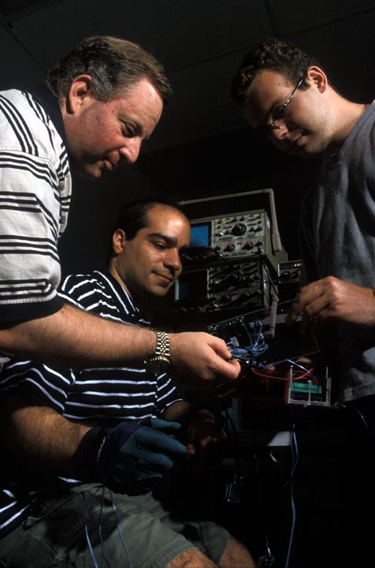
School of Engineering @ UB
  The fastest growing School of Engineering in the nation (among 300+ accredited engineering schools)
  The largest graduate engineering program in CT
  One of the three largest engineering programs in New England
  The only Ph.D. program in Computer Science and Engineering in New England
  Dual degree programs
  More than 75 full and part time faculty members
School of Engineering
University of Bridgeport
Graduate Education & Research Directions – 9.15.2010

Slide 19
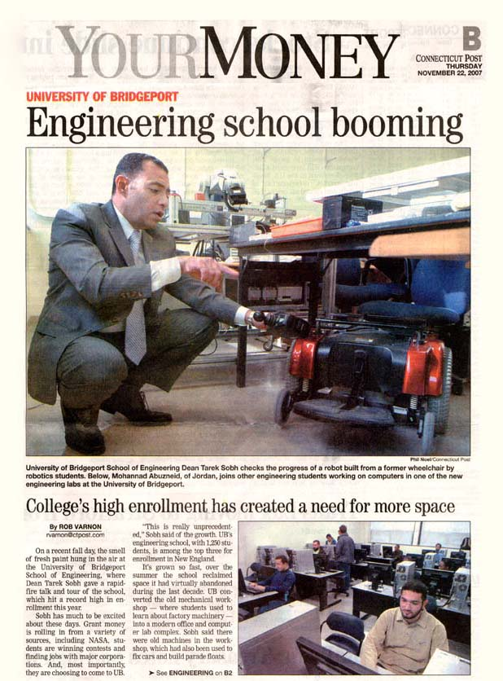
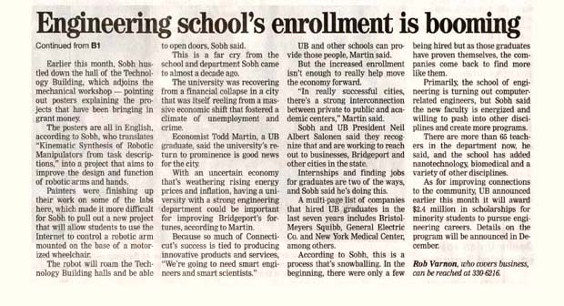
School of Engineering @ UB
“UB’s Engineering School,
with 1,250 students, is among
top three for enrollment
in New England.”
CT Post 11/22/2007
School of Engineering
University of Bridgeport
Graduate Education & Research Directions – 9.15.2010

Slide 20


Conferences
The School of Engineering has been the host of the largest international engineering research conference held on line for the last three years. CISSE (The International Joint Conferences on Computer, Information and Systems Sciences and Engineering) is the first high-caliber Research Conference in the world to be completely conducted online in real-time via the internet.
The School of Engineering recently started to host a colloquium series with vibrant and renowned speakers. Five internal and five external speakers are scheduled for every semester. This series has attracted regional attention and features world-class scholars and industry pioneers. In April 2008, the SOE hosted the IEEE Computer Society Spring Workshop.
The School of Engineering has been chosen to host two major international and regional conferences in 2009:
    REV (Remote Engineering and Virtual Instrumentation)
    ASEE (American Society for Engineering Education)
School of Engineering
University of Bridgeport
Graduate Education & Research Directions – 9.15.2010

Slide 21
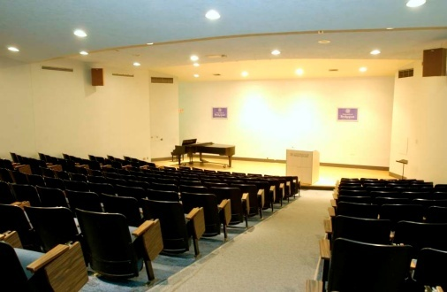
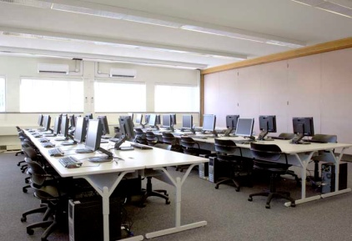
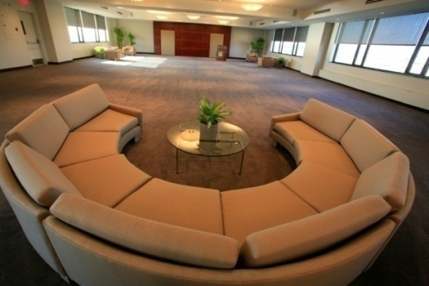
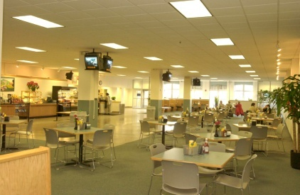
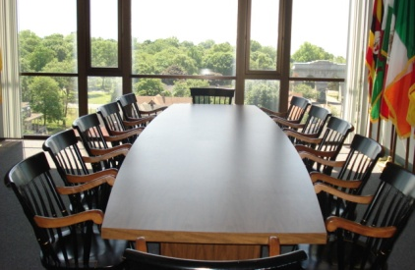

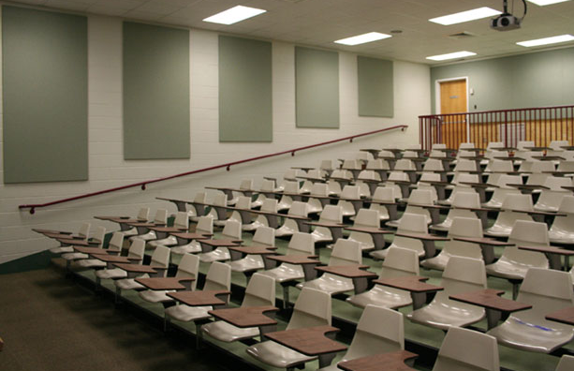
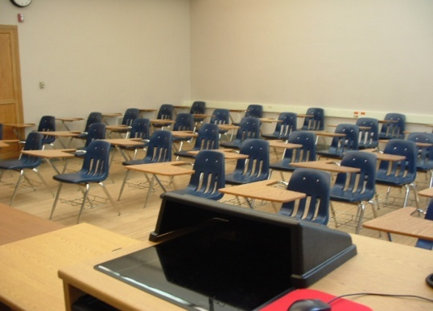
Facilities
School of Engineering
University of Bridgeport
Graduate Education & Research Directions – 9.15.2010

Slide 22
Facilities
16 state of the art computer/instruction labs.
Sample of Distinguished Research labs:
  RISC Project Lab. (Interdisciplinary Robotics, Intelligent Sensing, and Control): Director Prof. Tarek Sobh
  Wireless & Mobile Communications (WMC) Project Lab.: Director Prof. Khaled Elleithy
  VLSI/FPGA Project Lab.
  Multimedia Information Group (MIG) Project Lab.: Director
  Prof. Jeongkyu Lee
  PLC Lab.: Director Prof. Jack Toporovsky
School of Engineering
University of Bridgeport
Graduate Education & Research Directions – 9.15.2010

Slide 23

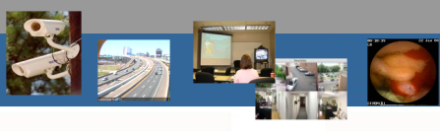
Multimedia Information Group (MIG) Laboratory
School of Engineering
University of Bridgeport
Graduate Education & Research Directions – 9.15.2010

Slide 24
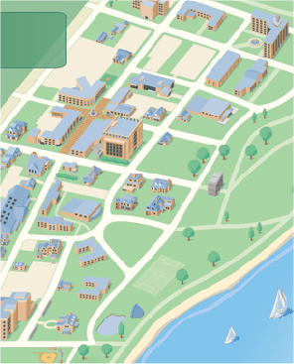
MIG@UB
UNIVERSITY OF BRIDGEPORT
Multimedia Information Group
Multimedia Information Group @ UB
  Department of Computer Science and Engineering at UB, CT
Location: Charles A. Dana Hall #234
People
  Prof. Jeongkyu Lee
  2 PhDs and 2 MS students
Collaborators
  Prof. JungHwan Oh at UNT
  Prof. Shou-jiang Tang at UTSW
  Prof. Dongwon Lee at PSU
http://www.bridgeport.edu/~jelee/mig
School of Engineering
University of Bridgeport
Graduate Education & Research Directions – 9.15.2010

Slide 25
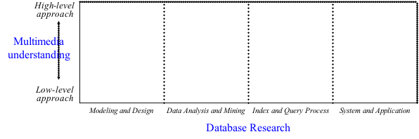



Our Vision
UNIVERSITY OF BRIDGEPORT
Multimedia Information Group
http://www.bridgeport.edu/~jelee/mig
School of Engineering
University of Bridgeport
Graduate Education & Research Directions – 9.15.2010

Slide 26
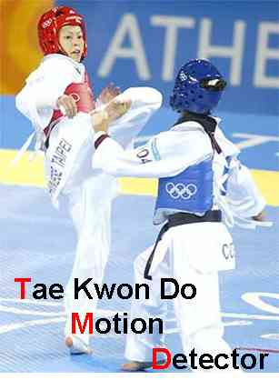

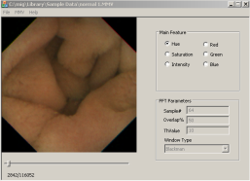
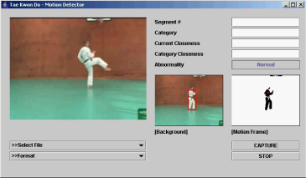
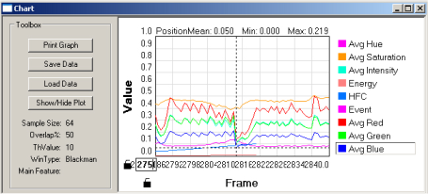
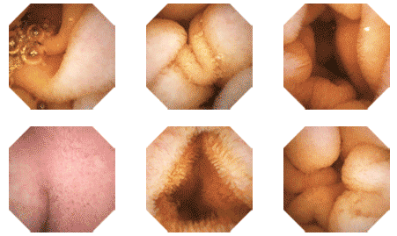
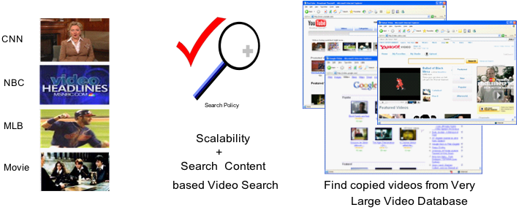


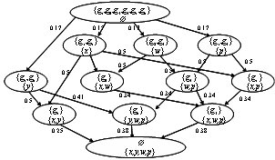

Active Research
UNIVERSITY OF BRIDGEPORT
Multimedia Information Group
SmartView project
TaeKwonDo project
Developing algorithms and S/W for event detections from
WCE (Wireless Capsule Endoscopy) videos
Funded from IntroMedic, Co. Ltd., Korea
Collaborator: Dr. Tang at UTSW, Dr. Oh at UNT
Developing algorithm and prototype system
for automatic judge of TaeKwonDo poomsae
Sponsor: International College at UB, WTF
Collaborator: Prof. Kim of Martial Art dept.
at UB
MIG
Developing a noble method for video and image matching
Applicatoin1: Video Copy Detection for YouTube
Applicatoin2: BIM (BLASTed Image matching)
Collaborator: Dr. Dongwon Lee at Penn State University
Developing a new algorithm for automatic generation of
Multimedia Ontology
Target applications: Medical videos, Surveillance camera,
and Military videos
Looking for sponsors
Vlinkage: Video Linkage project
Multimedia Ontology
http://www.bridgeport.edu/~jelee/mig
School of Engineering
University of Bridgeport
Graduate Education & Research Directions – 9.15.2010

Slide 27

University of Bridgeport
School of Engineering
Robotics, Intelligent Sensing and Control Lab
(RISC)
School of Engineering
University of Bridgeport
Graduate Education & Research Directions – 9.15.2010

Slide 28
Outline of Outgoing Project
Online Automation and Control: An Experiment in Distance Engineering Education
E-Learning: Case Studies in Web-Controlled Devices and Remote Manipulation
Prototyping Environment for Robot Manipulators
Manipulator Workspace Generation and Visualization in the Presence of Obstacles
Kinematic Synthesis of Robotic Manipulators from Task Descriptions
New concept in optimizing the manipulability index of serial Manipulators using SVD method
School of Engineering
University of Bridgeport
Graduate Education & Research Directions – 9.15.2010

Slide 29
Outline of Outgoing Project
Recovering 3-D Uncertainties from Sensory Measurements for Robotics Applications
Industrial Inspection and Reverse Engineering
Sensing Under Uncertainty for Mobile Robots
Robot Design and Dynamic Control Simulation Software Solutions From Task Points Description.
RISCBot II
School of Engineering
University of Bridgeport
Graduate Education & Research Directions – 9.15.2010

Slide 30
Online Distance Laboratories
Using Automation and Telerobotic (controlling devices from a distance) systems
Real-time laboratory experience via the internet
  Tele-operation of Mitsubishi Movemaster
  RISCBOT – A Web Enabled Autonomous Navigational Robot
  Tele-operation of the FESTO Process Controller
School of Engineering
University of Bridgeport
Graduate Education & Research Directions – 9.15.2010

Slide 31
Capabilities and Research
Facilities
Sensing under uncertainty.
Sensor-based distributed control schemes.
Control and planning for autonomous mobile systems.
Modeling and recovering uncertainty in 3-D structure and motion.
Dynamics and kinematics generation and analysis for multi-DOF robots.
Active observation and control of a moving agent under uncertainty.
Automation for genetics application.
Manipulator workspace generation in the presence of obstacles.
Turbulent flow analysis using sensors within a DES framework
School of Engineering
University of Bridgeport
Graduate Education & Research Directions – 9.15.2010

Slide 32
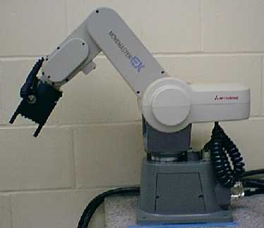
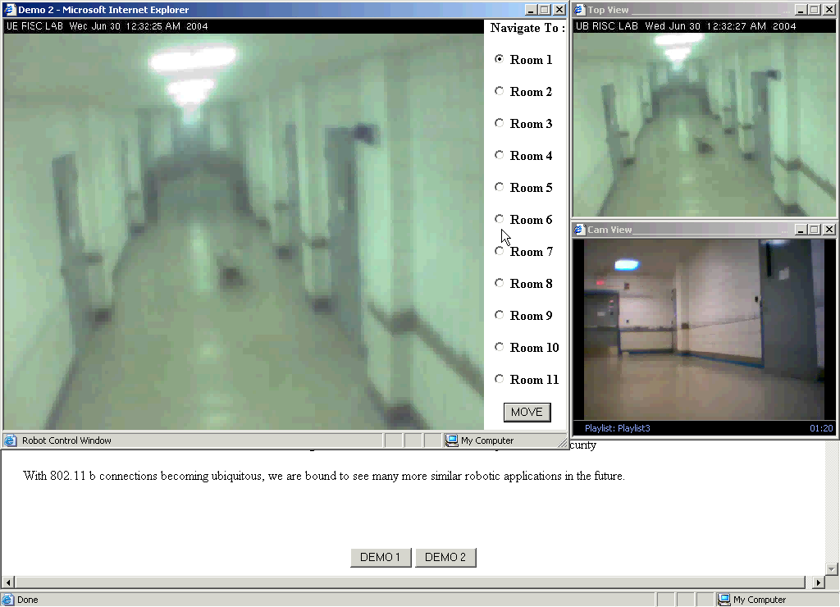
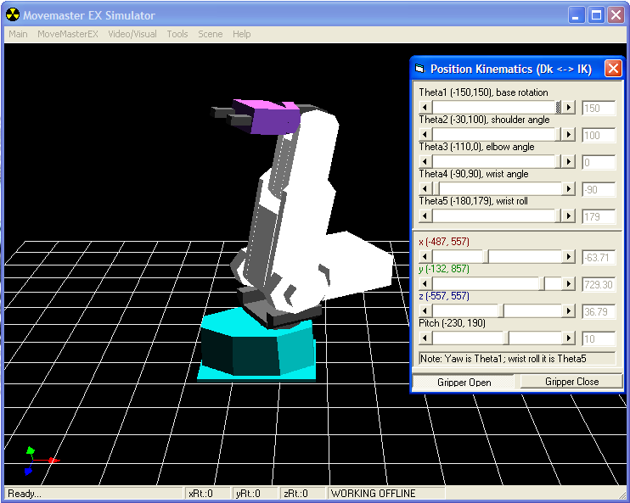
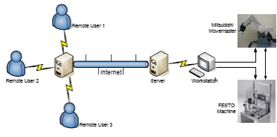
Other Projects
RISC
School of Engineering
University of Bridgeport
Graduate Education & Research Directions – 9.15.2010

Slide 33
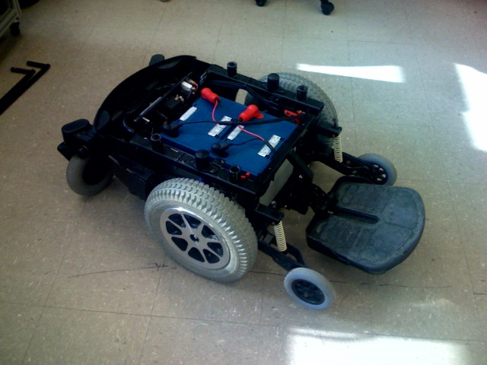
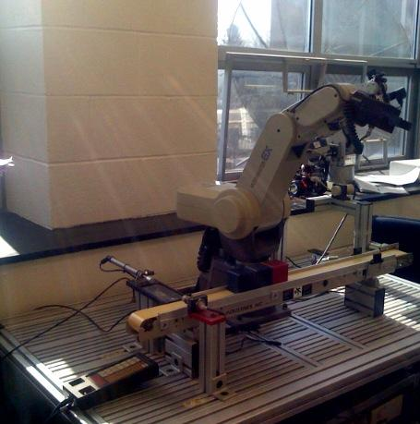
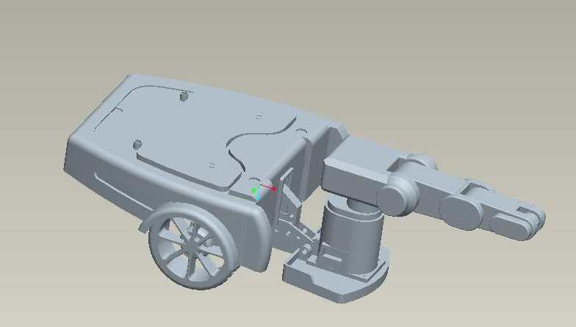
RISCbot II
School of Engineering
University of Bridgeport
Graduate Education & Research Directions – 9.15.2010

Slide 34

Wireless & Mobile Communications (WMC) Laboratory
School of Engineering
University of Bridgeport
Graduate Education & Research Directions – 9.15.2010

Slide 35
Current Research Projects
Wireless Multiuser Communications for Cellular and Mobile Networks
  BER and SNR Analysis of DS-CDMA Cellular Networks
  Multiple Access interference (MAI) Cancellation for Wireless Multiuser Receivers
  Analysis of Processing Gain for Wireless Multiuser DS-CDMA Systems
  Computational Complexity and Algorithm Optimization for 3G Cellular Networks
School of Engineering
University of Bridgeport
Graduate Education & Research Directions – 9.15.2010

Slide 36
Research Projects
2. Wireless Mesh Networks
  The Use of Orthogonal Frequency Code Division (OFCD) in Broadband Wireless Mesh Networks
  Efficient Routing Algorithms for Wireless Mesh-Hypercube (M-H) Networks
School of Engineering
University of Bridgeport
Graduate Education & Research Directions – 9.15.2010

Slide 37
Research Projects (Cont’d)
3. Mobile Ad Hoc Networks (MANET)
  The Best and Worst Case Capacity Analysis of MANET
  Efficient DSR Based Routing Scheme for MANET
  Minimizing the Malicious Behavior of Mobile Nodes for Maximizing the MANET Data Throughput
4. Wireless Sensor Networks
  Resource Optimization in Wireless Sensor Networks Via Self-Adaptive Methodology
  Minimizing the Energy Consumption of Wireless Sensor Nodes Using Active Node Optimization Method
School of Engineering
University of Bridgeport
Graduate Education & Research Directions – 9.15.2010

Slide 38
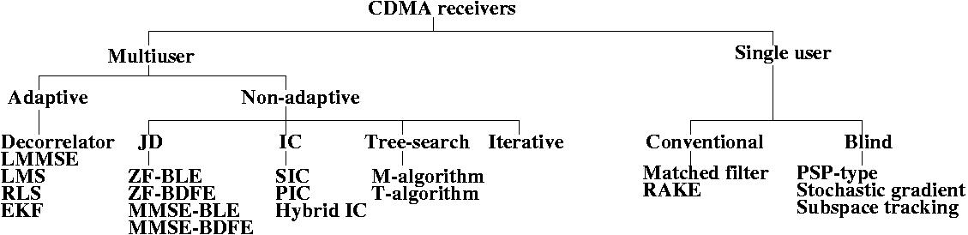
Related Recent Results
CDMA Receiver: Multiuser Receiver
A class of CDMA receivers known as multiuser receivers
It exploit the available information about the spreading sequences and mobile channel impulse responses of all the CDMA users
The goal is to improve the performance of the wireless CDMA users
WMC research group focuses on this part
Classification of CDMA detectors
School of Engineering
University of Bridgeport
Graduate Education & Research Directions – 9.15.2010

Slide 39
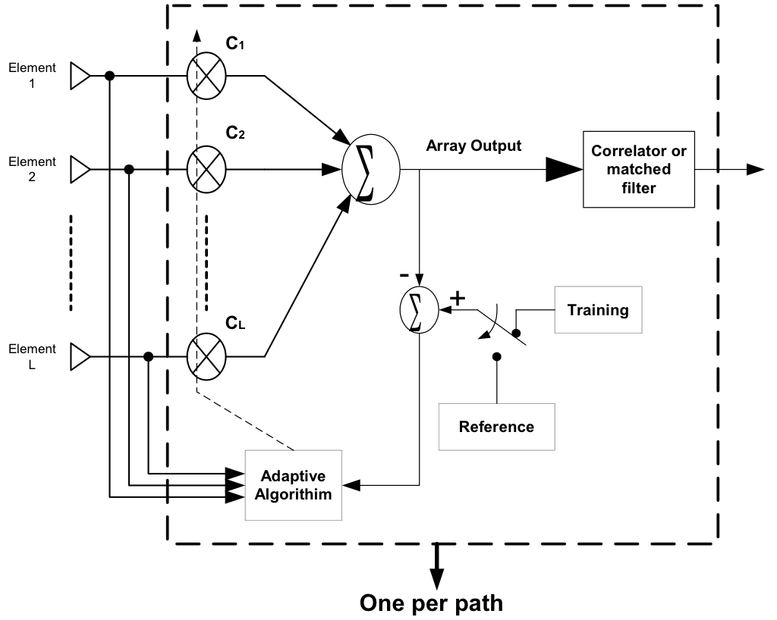
Related Recent Results
Antenna Design for Cellular Networks
Advantages
  Co-channel interference reduction
  Collect multipath components
  Delay spread reduction
  reduce handoff rate
  stand alone technique
Disadvantages
  Linear increase in Interference
  Cancel only L-1 interference
  Difficult to achieve convergence in low SNR
WMC research group focuses on the utilization of adaptive antenna array with CDMA systems for achieving optimal performance
Figure: Adaptive Antenna Array
School of Engineering
University of Bridgeport
Graduate Education & Research Directions – 9.15.2010

Slide 40



Hybrid Projectile Project @UB
Period: Aug. 1, 2008 ~ Dec. 31, 2008
Amount: $ 20,000
Members
PI: Dr. Tarek Sobh
Vice President for Graduate Studies and Research
Dean of the School of Engineering
CoPI: Dr. Khaled Elleithy
Professor of CSE
Associate Dean for
Graduate Programs
CoPI: Dr. Jeongkyu Lee
Assistant Professor
Dept. of CSE
School of Engineering
University of Bridgeport
Graduate Education & Research Directions – 9.15.2010

Slide 41
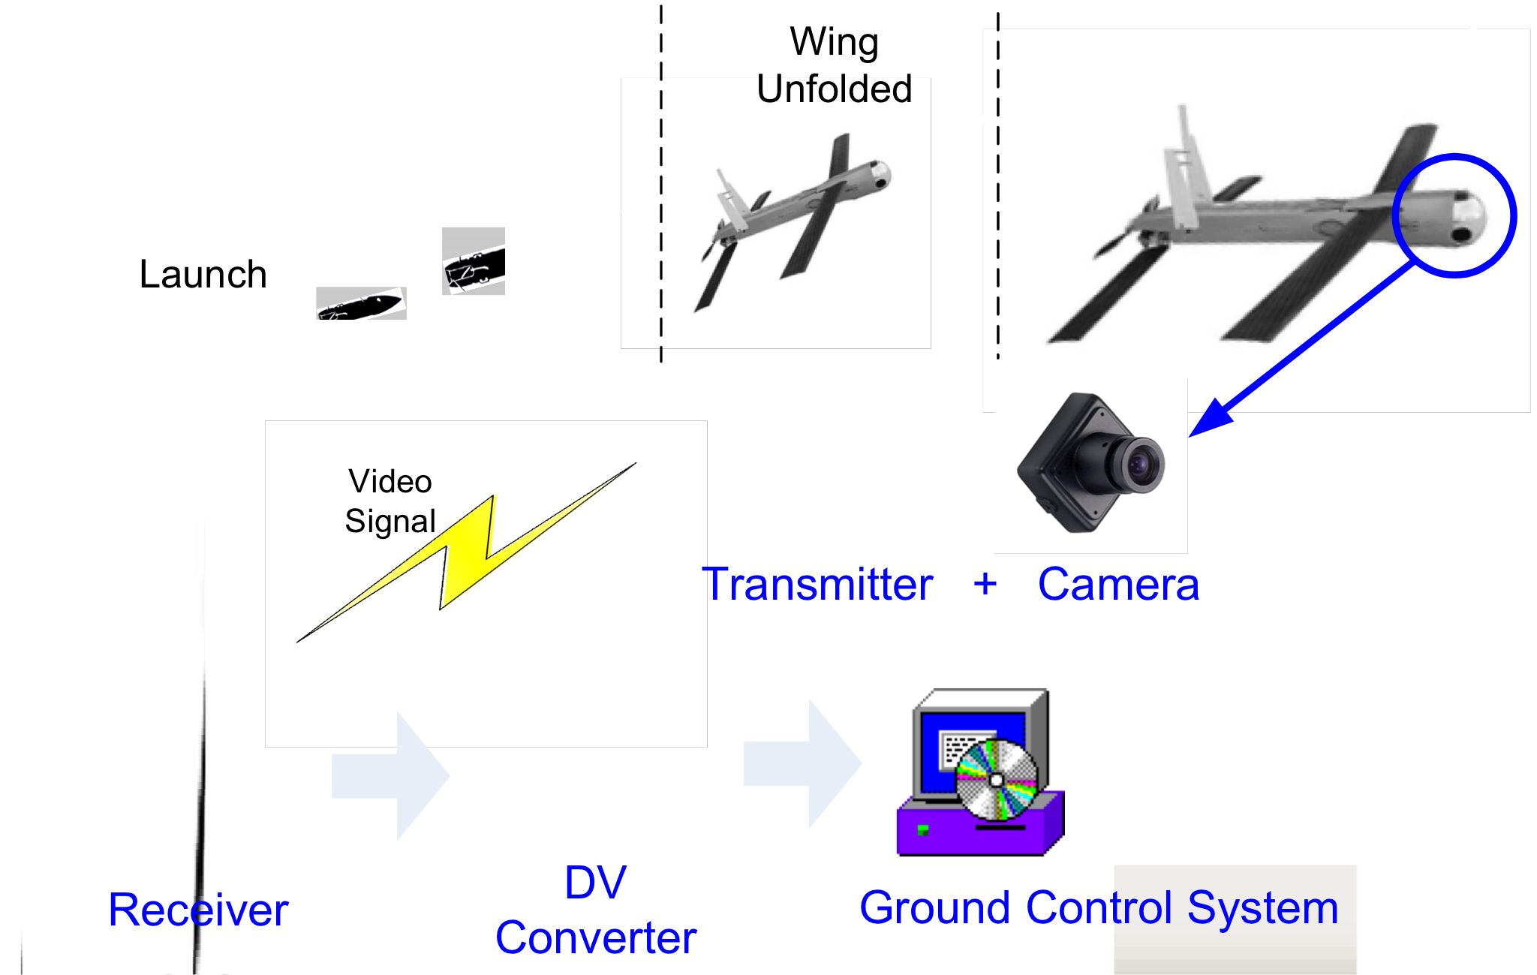
Overview
School of Engineering
University of Bridgeport
Graduate Education & Research Directions – 9.15.2010

Slide 42
Work Tasks
Task #1: Investigation Wireless transmitters and Receivers
Task #2: System Implementation
Task #3: Wireless Camera Component
Task #4: Demonstrations
School of Engineering
University of Bridgeport
Graduate Education & Research Directions – 9.15.2010

Slide 43
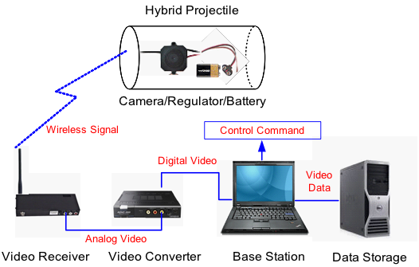
Overview of Wireless Camera Component
School of Engineering
University of Bridgeport
Graduate Education & Research Directions – 9.15.2010

Slide 44
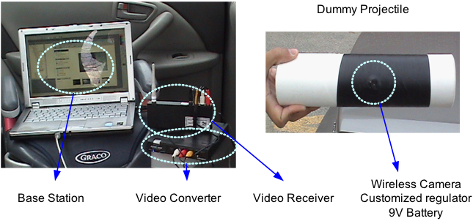
Integration of Wireless Camera with Dummy Projectile
School of Engineering
University of Bridgeport
Graduate Education & Research Directions – 9.15.2010

Slide 45
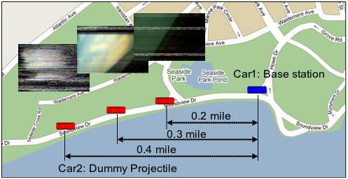
Demo 1: Wireless Camera Component
When: February 27, 2009 2:30 PM ~ 3:30 PM
Where: Seaside Park, Bridgeport, Connecticut
Car 1 (Blue): Base station including laptop, video receiver,
and converter
Car 2 (Red): Dummy projectile including wireless camera and battery
School of Engineering
University of Bridgeport
Graduate Education & Research Directions – 9.15.2010

Slide 46
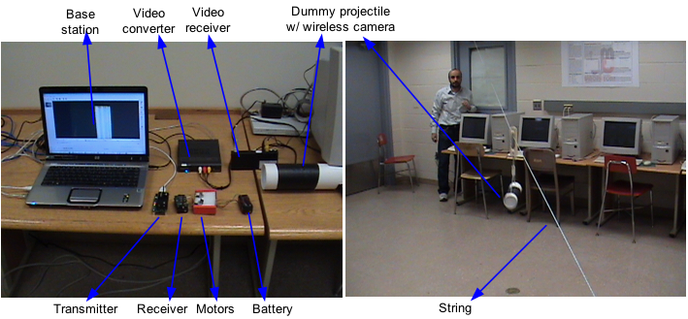
Demo 2:Integration of all components
When: March 12, 2009 3:00 PM ~ 4:00 PM
Where: Wireless Mobile laboratory, University of Bridgeport, CT
Base Station: control software, displaying and processing software
Wireless Component: transmitter, receiver, and control motors
Dummy Projectile: wireless camera and battery
School of Engineering
University of Bridgeport
Graduate Education & Research Directions – 9.15.2010

Slide 47
Prototype
A prototype was implemented which demonstrates the following functions:
A wireless camera sends a signal to the base station.
The base station sends a wireless signal to the control circuitry of the motors installed in the projectile.
The control circuitry advances the steppers motors forward or backward to control the wings of the projectile.
School of Engineering
University of Bridgeport
Graduate Education & Research Directions – 9.15.2010

Slide 48
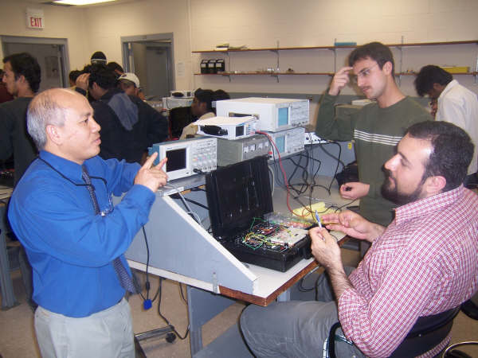
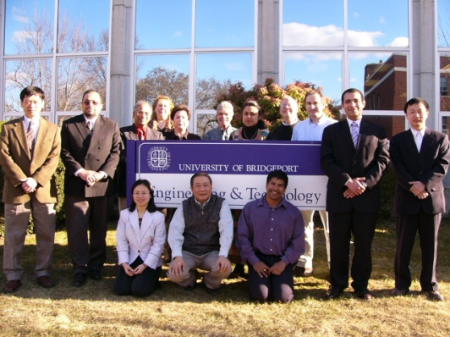
Faculty
The School of Engineering currently has more than 75 full and part time faculty members. The number of full time faculty has doubled in the past two years.
The School of Engineering faculty have produced more than a dozen books in the past two years on topics varying from Engineering Education, Computing Sciences and Software Engineering, E-Learning, Instruction Technology, Algorithms and Techniques in Automation, Robotics, Industrial Electronics, Telecommunications, Information Technology and Strategic Sourcing and Outsourcing.
The number of faculty and student scholarly publications in world-class academic conferences and journals in the last three years has been over 400.
School of Engineering
University of Bridgeport
Graduate Education & Research Directions – 9.15.2010

Slide 49
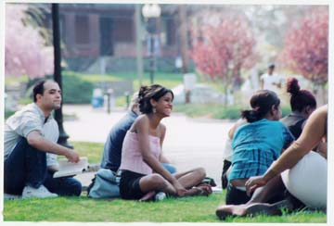
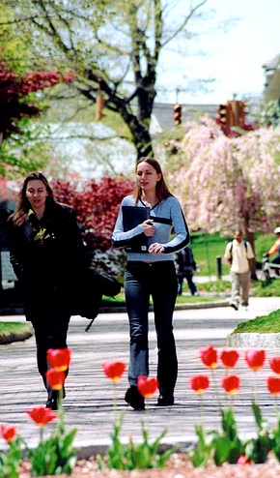

Dr. Tarek Sobh
Vice President Graduate Studies and Research Division &
Dean, School of Engineering
Distinguished Professor of Engineering & Computer Science
University of Bridgeport
E-Mail: sobh@bridgeport.edu
See you next year at the University of Bridgeport!
School of Engineering
University of Bridgeport
Graduate Education & Research Directions – 9.15.2010

